Slide 1

AERIAL SYSTEMS
Flight Dynamics of UAVs
SUBMITTED BY
PULKIT PANDEY
2K19/EP/076

Slide 2
ACKNOWLEDGEMENT
Presentation, Inspiration and Motivation have always played a key role in success of any project.
I express a deep sense of gratitude to Dr Rinku Sharma, Professor, Department of Applied Physics, DTU to encourage to highest peak and to provide with the opportunity to prepare the project. I am immensely obliged to her for her elevating inspiration, encouraging guidance and kind supervision in the completion of the project. I am also thankful for her invaluably constructive criticism and advises throughout the working of the project.
.

Slide 3

TABLE OF CONTENTS
Aerial Systems(UAVs)
01
Dynamics of UAVS
02
Inertial Measurement Unit
03
Arduino Simulation
04

Slide 4


INTRODUCTION TO UNMANNED AERIAL VEHICLE
An unmanned aerial vehicle(UAV), commonly known as a drone, is an aerial system without a human pilot on board. Its flight is either controlled autonomously by computers in the vehicle. A common drone consist of four motors, control circuitry in middle and propellers mounted on its rotors. Two rotors rotate in clockwise direction while other two in counter clockwise directions to provide appropriate thrusts.

Slide 5

Top View

Slide 6
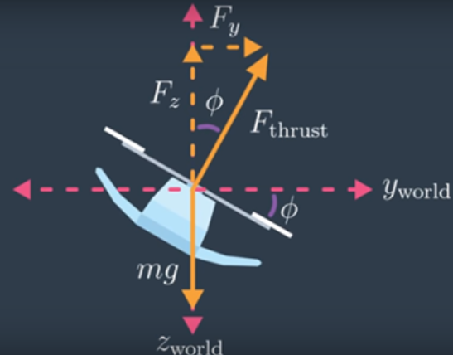

Orientation and Positions
A drone has orientation and position attributes which can be determined using coordinates system(x,y,z coordinates) with certain angles(theta,phi,psi) with respect to world /Inertial frame. To measure the angles, usually drone’s onboard IMU is used. This sensor measures how fast drone’s body is rotating around it’s body frame. This sensor returns angular velocity as it outputs with respect to body frame.
We can represent an orientation in 3D Euclidean space with three numbers. The sequence of rotation about basis vectors are called Euler angle sequence.

Slide 7
Euler Angles
Pitch – Roll - Yaw
Euler angles are a method to determine and represent the rotation of a body as expressed in a given coordinate frame. They are defined as phi for x axis rotation, theta for y axis rotation and psi for z axis rotation. Any rotation can be described through a combination of these angles.
Rotation of any aerial system is expressed using these Tait-Bryan angles. Consider an orthogonal axis system passing through the centre of gravity of drone. Rotation about each axis is given by these angles.

Slide 8

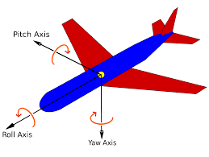
ANGLES ANALYSIS
ROLL
PITCH
Yaw
Rotation around front to back axis is called roll.
Rotation around side to side axis is called pitch.
Rotation around vertical axis is called yaw

Slide 9
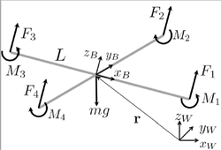



FORCES AND MOMENTS
Each rotating propeller produces an upward thrust and a torque.
Apart from upward thrust these rotating propellers also generates an opposing rotating spin called Torque or moment.
Upward thrust helps drone to counter its weight while varying torques help to traverses in drone in air.

Slide 10

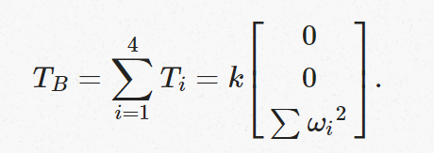
FORCE ACTING ON DRONE
Motors are used in drones. Motors consumes electric energy and then give rise to thrust. Each motor produces its own thrust(Ti) which adds up to give total thrust(Tb). This total thrust w.r.t body-frame is directly proportional to square of angular velocity of motor and acts in positive z direction.

Slide 11

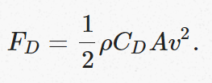
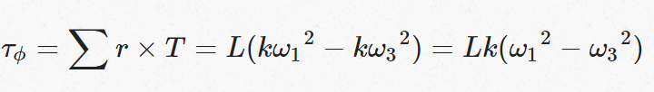
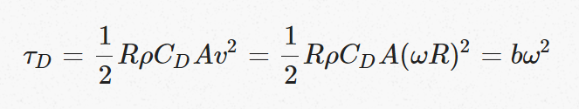

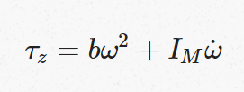
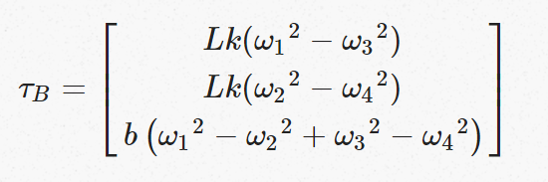

Torque
Torque due to drag
Torque equations
Torque about z axis
Net Torque

Slide 12

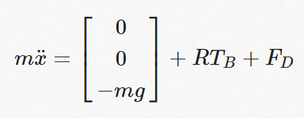
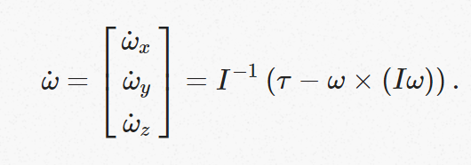
EQUATIONS OF MOTION
LINEAR MOTION
In inertial frame, the acceleration
of quadcopter is due to thrust,
gravity and drag force. Here R is
rotation matrix to map thrust vector
to inertial frame. Fd is drag force
,x is position vector of quadcopter
and Tb is thrust force.
ROTATIONAL MOTION
It is easier to express rotation of body with respect to body frame about its own inertial axis.
According to Euler’s equation.
Where w is angular velocity vector, I is inertia matrix and tau is torque acting on body. Thus;

Slide 13

PHYSICAL MODEL
EQUIPEMNTS AND SOFTWARE USED:
BREADBOARD
AURDUINO NANO
INERTIAL MEASUREMENT UNIT(MPU6050)
JUMPER WIRES
AURDUINO SIMULATION ENVIRONMENT
C++/C.

Slide 14

INERTIAL MEASUREMENT UNIT
An IMU is a specific type of sensor that measures angular rate and force. IMU is composed of 3-axis gyroscopes and 3-axis accelereometer which makes it a 6- axis IMU. IMU is just a combination of these two sensors.
It measures angular velocity about each axis(pitch, roll, yaw axis).
GYROSCOPE
ACCELEROMETER
It measures linear acceleration across each axis.
TEMPERATURE
It measures temperature and humidity of surrounding vicinity.

Slide 15
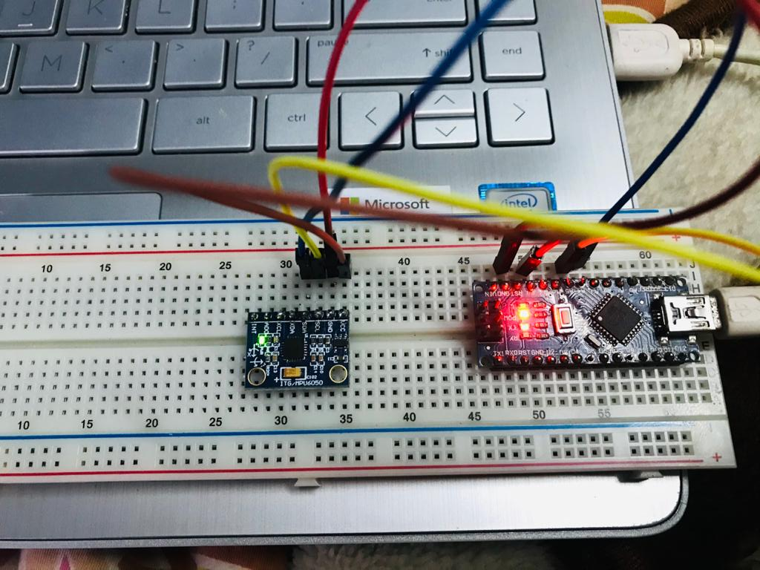

Slide 16
THANK YOU

